Slide 1
19CSE305 MACHINE LEARNING Lecture 5
Data Preprocessing

Slide 2
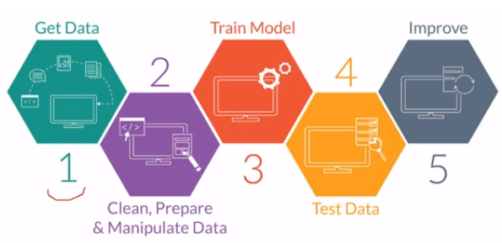
Traditional ML Workflow

Slide 3
Data Preprocessing
Why preprocess the data?
Data cleaning
Data integration and transformation
Data reduction
Discretization
Summary

Slide 4
Why Data Preprocessing?
Data in the real world is dirty
incomplete: missing attribute values, lack of certain attributes of interest, or containing only aggregate data
e.g., occupation=“”
noisy: containing errors or outliers-Deviates from actual data
e.g., Salary=“-10”
inconsistent: containing discrepancies in codes or names
e.g., Age=“42” Birthday=“03/07/1997”
e.g., Was rating “1,2,3”, now rating “A, B, C”
e.g., discrepancy between duplicate records

Slide 5
Why is Data Preprocessing Important?
No quality data, less accurate results!
Quality decisions must be based on quality data
e.g., duplicate or missing data may cause incorrect or even misleading statistics.
Data preparation, cleaning, and transformation comprises the majority of the work in a data mining and Machine Learning application (90%).

Slide 6
Major Tasks in Data Preprocessing
Data cleaning
Fill in missing values, smooth noisy data, identify or remove outliers and noisy data, and resolve inconsistencies
Data integration
Integration of multiple databases, or files
Data transformation
Normalization and aggregation
Data reduction
Obtains reduced representation in volume but produces the same or similar analytical results
Data discretization
Automatic generation of concept hierarchies from numerical data

Slide 7
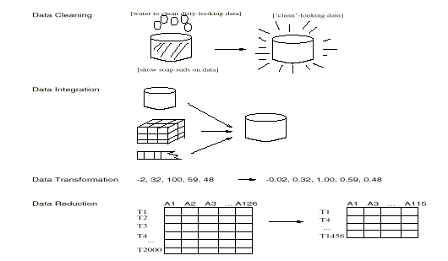
Forms of data preprocessing

Slide 8
Data Preprocessing
Why preprocess the data?
Data cleaning
Data integration and transformation
Data reduction
Discretization
Summary

Slide 9
Data Cleaning
Importance
“Data cleaning is the number one problem in data warehousing”
Data cleaning tasks
Fill in missing values
Identify outliers and smooth out noisy data
Correct inconsistent data
Resolve redundancy caused by data integration

Slide 10
Missing Data
Data is not always available
E.g., many tuples have no recorded values for several attributes, such as customer income in sales data
Missing data may be due to
equipment malfunction
inconsistent with other recorded data and thus deleted
data not entered due to misunderstanding
certain data may not be considered important at the time of entry
not register history or changes of the data

Slide 11
Missing Data Example Bank Acct Totals - Historical
Name | SSN | Address | Phone # | Date | Acct Total
John Doe | 111-22-3333 | 1 Main St Bedford, Ma | 111-222-3333 | 2/12/1999 | 2200.12
John W. Doe |  | Bedford, Ma |  | 7/15/2000 | 12000.54
John Doe | 111-22-3333 |  |  | 8/22/2001 | 2000.33
James Smith | 222-33-4444 | 2 Oak St Boston, Ma | 222-333-4444 | 12/22/2002 | 15333.22
Jim Smith | 222-33-4444 | 2 Oak St Boston, Ma | 222-333-4444 |  | 12333.66
Jim Smith | 222-33-4444 | 2 Oak St Boston, Ma | 222-333-4444

Slide 12
How to Handle Missing Data?
Ignore the tuple: usually done when class label is missing (assuming the tasks in classification—not effective when the percentage of missing values per attribute varies considerably.
Fill in the missing value manually: tedious + infeasible?
Use a global constant to fill in the missing value: e.g., “unknown”, a new class?!
Use the attribute mean/median to fill in the missing value
Use the attribute mean for all samples belonging to the same class to fill in the missing value: smarter
Use the most probable value to fill in the missing value: inference-based such as Bayesian formula or decision tree

Slide 13
Noisy Data
Noise: random error or variance in a measured variable
Incorrect attribute values may be due to
faulty data collection instruments
data entry problems
data transmission problems
technology limitation
inconsistency in naming convention
Other data problems which requires data cleaning
duplicate records
incomplete data
inconsistent data

Slide 14
Noisy Data Example Bank Acct Totals - Historical
Name | SSN | Address | Phone # | Date | Acct Total
John Doe | 111-22-3333 | 1 Main St Bedford, Ma | 111-222-3333 | 2/12/1999 | 2200.12
John Doe | 111-22-3333 | 1 Main St Bedford, Ma | 111-222-3333 | 2/12/1999 | 2233.67
James Smith | 222-33-4444 | 2 Oak St Boston, Ma | 222-333-4444 | 12/22/2002 | 15333.22
James Smith | 222-33-4444 | 2 Oak St Boston, Ma | 222-333-4444 | 12/23/2003 | 15333000.00

Slide 15
How to Handle Noisy Data?
Binning method:
first sort data and partition into (equi-depth) bins
then one can smooth by bin means, smooth by bin median, smooth by bin boundaries, etc.
Clustering
detect and remove outliers
Combined computer and human inspection
detect suspicious values and check by human
Regression
smooth by fitting the data into regression functions

Slide 16
Simple Discretization Methods: Binning
Equal-width (distance) partitioning:
It divides the range into N intervals of equal size: uniform grid
if A and B are the lowest and highest values of the attribute, the width of intervals will be: W = (B-A)/N.
The most straightforward
But outliers may dominate presentation
Skewed data is not handled well.
Equal-depth (frequency) partitioning:
It divides the range into N intervals, each containing approximately same number of samples
Good data scaling
Managing categorical attributes can be tricky.

Slide 17
Binning Methods for Data Smoothing
* Sorted data for price (in dollars): 4, 8, 9, 15, 21, 21, 24, 25, 26, 28, 29, 34
* Partition into (equi-width) bins:
- Bin 1 (4-14): 4, 8, 9
- Bin 2(15-24): 15, 21, 21, 24
- Bin 3(25-34): 25, 26, 28, 29, 34
* Smoothing by bin means:
- Bin 1: 7, 7, 7
- Bin 2: 20, 20, 20, 20
- Bin 3: 28, 28, 28, 28, 28
* Smoothing by bin boundaries:
- Bin 1: 4, 4, 4
- Bin 2: 15, 24, 24, 24
- Bin 3: 25, 25, 25, 25, 34

Slide 18
Binning Methods for Data Smoothing (continued)
* Sorted data for price (in dollars): 4, 8, 9, 15, 21, 21, 24, 25, 26, 28, 29, 34
* Partition into (equi-depth) bins:
- Bin 1: 4, 8, 9, 15
- Bin 2: 21, 21, 24, 25
- Bin 3: 26, 28, 29, 34
* Smoothing by bin means:
- Bin 1: 9, 9, 9, 9
- Bin 2: 23, 23, 23, 23
- Bin 3: 29, 29, 29, 29
* Smoothing by bin boundaries:
- Bin 1: 4, 4, 4, 15
- Bin 2: 21, 21, 25, 25
- Bin 3: 26, 26, 26, 34

Slide 19
Cluster Analysis
Allows detection and removal of outliers

Slide 20
Regression
y
Y1
Y1’
y = x + 1
X1
x
Linear regression – find the best line to fit two
variables and use regression function to smooth data

Slide 21
Data Preprocessing
Why preprocess the data?
Data cleaning
Data integration and transformation
Data reduction
Discretization
Summary

Slide 22
Data Integration
Data integration:
combines data from multiple sources into a coherent store
Schema integration
integrate metadata from different sources
Entity identification problem: identify real world entities from multiple data sources, e.g., A.cust-id ≡ B.cust-#
Detecting and resolving data value conflicts
for the same real world entity, attribute values from different sources are different
possible reasons: different representations, different scales, e.g., metric vs. British units

Slide 23
Web information integration
Many integration tasks,
Integrating Web query interfaces (search forms)
Integrating ontologies (taxonomy)
Integrating extracted data
Integrating textual information
E.g., entity linking, paraphrasing, etc.
…
E.g., integration of query interfaces.
Many web sites provide forms to query deep web
Applications: meta-search and meta-query

Slide 24
Handling Redundant Data in Data Integration
Redundant data occur often when integration of multiple databases
The same attribute may have different names in different databases
One attribute may be a “derived” attribute in another table, e.g., annual revenue
Redundant data may be able to be detected by correlation analysis
Careful integration of the data from multiple sources may help reduce/avoid redundancies and inconsistencies and improve mining speed and quality

Slide 25
Handling Redundant Data
Some redundancies can be detected by correlation analysis
Correlation coefficient for numeric data
Chi ‐square test for categorical data
These can be also used for data reduction

Slide 26
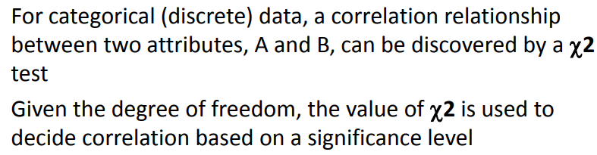
Chi-square Test

Slide 27
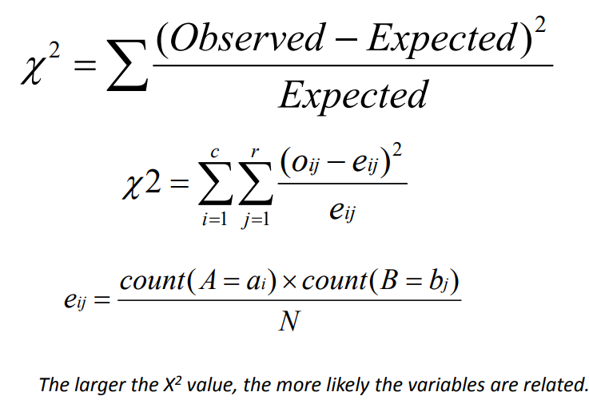

Chi-square Test for Categorical Data

Slide 28
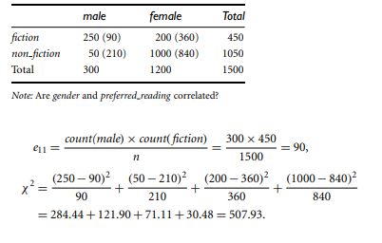
Chi-square Test

Slide 29
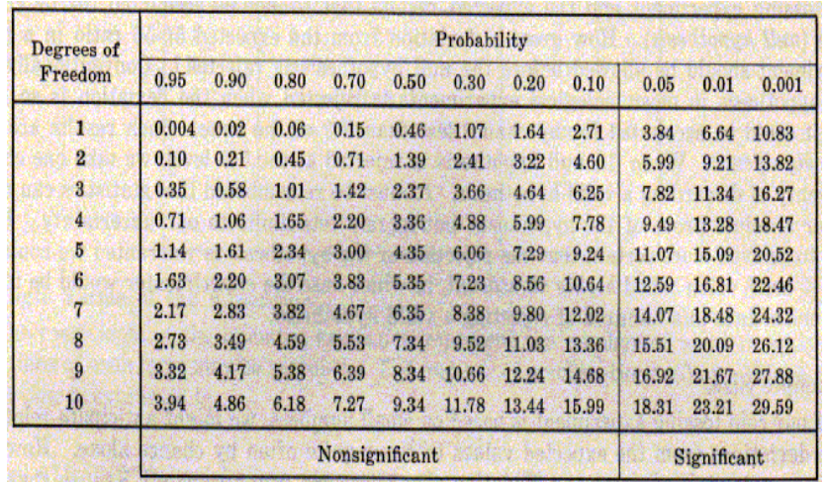
Table of Percentage Points of the χ2 Distribution

Slide 30
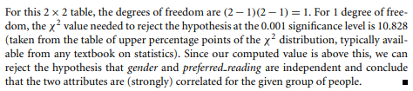

Slide 31
Correlation Coefficient for Numeric Data
R _{A,B} = Sum (A-A’) (B-B’)
(n-1) sdA sdB
Where A’ = mean value of A
sum (A)
n
sdA = standard deviation of A
SqRoot ( Sum (A-A’)²)
n-1
<0 negatively correlated, =0 no correlation, >0 correlated – consider removal of A or B

Slide 32
Correlational Analysis Example
A – 2, 5, 6, 8, 22, 33, 44, 55
B – 6, 7, 22, 33, 44, 66, 67, 70
A’ = 22, B’ = 45
Sum (A-A’) = -1, Sum (B-B’) = -45
sdA = .378, sdB = 17.008
R_{A,B} = 45/45.003 = .999
R_{A,B}>0 - correlated – consider removal of A or B

Slide 33
Data Transformation
Smoothing: remove noise from data
Aggregation: summarization, data cube construction
Generalization: concept hierarchy climbing
Normalization: scaled to fall within a small, specified range
min-max normalization
z-score (zero mean) normalization
normalization by decimal scaling
Attribute/feature construction
New attributes constructed from the given ones to help in the data mining process

Slide 34
Data Transformation: Normalization
min-max normalization
Example – income, min $55,000, max $150000 – map to 0.0 – 1.0
$73,600 is transformed to :
73600-55000 (1.0 – 0) + 0 = 0.196
150000-55000

Slide 35
Data Transformation: Normalization
z-score normalization
Example – income, mean $33000, sd $11000
$73600 is transformed to :
73600-33000 = 3.69
11000

Slide 36
Data Transformation: Normalization
normalization by decimal scaling
Example recorded values : -722 to 821
Divide each value by 1000
- 722 normalizes to -.772
821 normalizes to 0.821
Where j is the smallest integer such that Max(| |)<1

Slide 37
Attribution Construction
New attributes are constructed from given attributes and added in order to help improve accuracy and understanding of structure in high ‐dimension data
Example – Add the attribute area based on the attributes height and width

Slide 38
Data Preprocessing
Why preprocess the data?
Data cleaning
Data integration and transformation
Data reduction
Discretization
Summary

Slide 39
Data Reduction Strategies
Data is too big to work with
Data reduction
obtain a reduced representation of the data set that is much smaller in volume, yet closely maintains the integrity of the original data

Slide 40
Data Reduction Strategies
Data reduction strategies
(Data Cube)Aggregation
Attribute (Subset) Selection
Dimensionality Reduction
Numerosity Reduction
Data Discretization
Concept Hierarchy Generation

Slide 41
Data Cube Aggregation
Summarize (aggregate) data based on dimensions
The resulting data set is smaller in volume, without loss of information necessary for analysis task
Concept hierarchies may exist for each attribute, allowing the analysis of data at multiple levels of abstraction

Slide 42
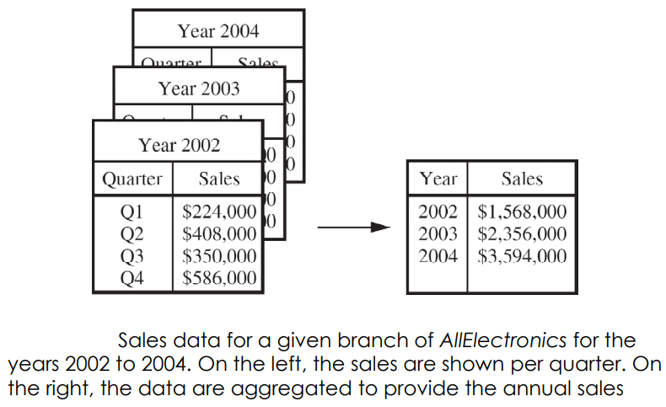
Data Aggregation

Slide 43
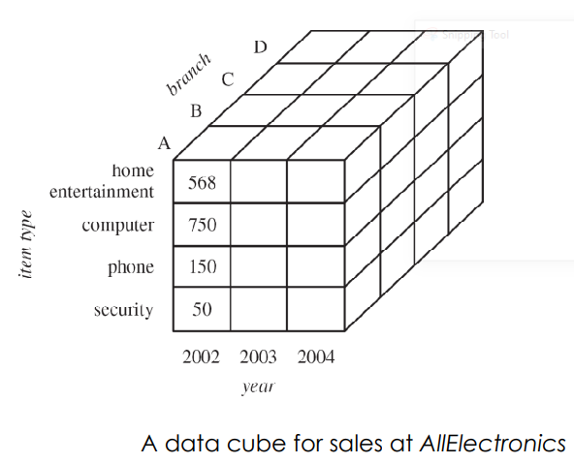
Data Cube
Provide fast access to pre‐computed, summarized data, thereby benefiting on‐line analytical processing as well as data mining

Slide 44
Attribute Subset Selection
Attribute selection can help in the phases of data mining (knowledge discovery) process
By attribute selection,
we can improve data mining performance (speed of learning, predictive accuracy, or simplicity of rules)
we can visualize the data for model selected
we reduce dimensionality and remove noise.

Slide 45
Attribute Subset Selection
Attribute (Feature) selection is a search problem
Search directions
(Sequential) Forward selection
(Sequential) Backward selection (elimination)
Bidirectional selection
Decision tree algorithm (induction)

Slide 46
Attribute Subset Selection
Attribute (Feature) selection is a search problem
Search strategies
Exhaustive search
Heuristic search
Selection criteria
Statistic significance
Information gain
etc.

Slide 47
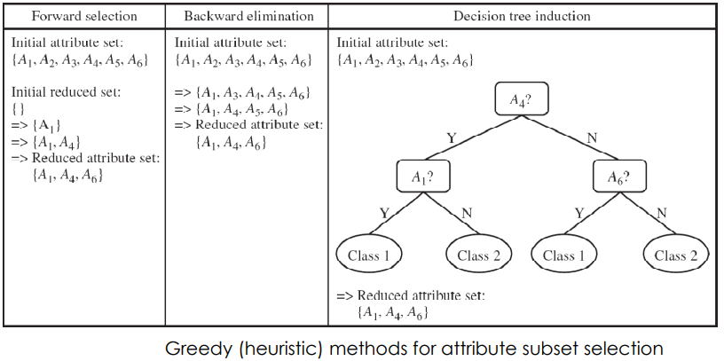
Attribute Subset Selection

Slide 48
Data Compression
String compression
There are extensive theories and well-tuned algorithms
Typically lossless
But only limited manipulation is possible without expansion
Audio/video compression
Typically lossy compression, with progressive refinement
Sometimes small fragments of signal can be reconstructed without reconstructing the whole
Time sequence is not audio
Typically short and vary slowly with time

Slide 49
Data Compression
Original Data
Compressed Data
lossless
lossy
Original Data Approximated

Slide 50
Wavelet Transforms
Discrete wavelet transform (DWT): linear
signal processing
Compressed approximation: store only a small fraction of the strongest of the wavelet coefficients
Similar to discrete Fourier transform (DFT), but better lossy compression, localized in space
Method:
Length, L, must be an integer power of 2 (padding with 0s, when necessary)
Each transform has 2 functions: smoothing, difference
Applies to pairs of data, resulting in two set of data of length L/2
Applies two functions recursively, until reaches the desired length
Haar2
Daubechie4

Slide 51
Principal Component Analysis
Given N data vectors from k-dimensions, find c <= k
orthogonal vectors that can be best used to represent data
The original data set is reduced to one consisting of N data vectors on c principal components (reduced dimensions)
Each data vector is a linear combination of the c principal component vectors
Works for numeric data only
Used when the number of dimensions is large

Slide 52
Principal Component Analysis
X2
Y1
Y2
X1

Slide 53
Numerosity Reduction
Parametric methods
Assume the data fits some model, estimate model parameters, store only the parameters, and discard the data (except possible outliers)
Log-linear models: obtain value at a point in m-D space as the product on appropriate marginal subspaces
Non-parametric methods
Do not assume models
Major families: histograms, clustering, sampling

Slide 54
Regression and Log-Linear Models
Linear regression: Data are modeled to fit a straight line
Often uses the least-square method to fit the line
Multiple regression: allows a response variable Y to be modeled as a linear function of multidimensional feature vector
Log-linear model: approximates discrete multidimensional probability distributions

Slide 55
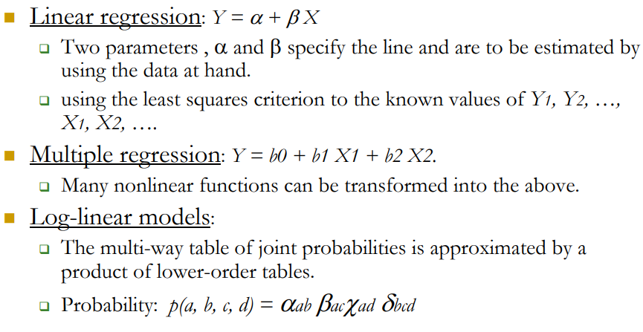
Regress Analysis and Log-Linear Models

Slide 56
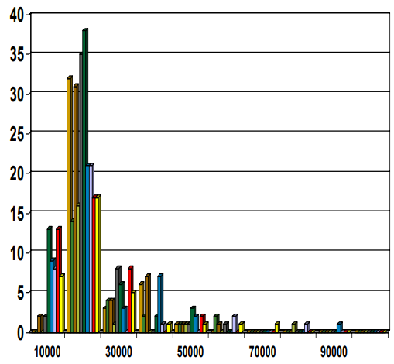
Histograms
A popular data reduction technique
Divide data into buckets and store average (sum) for each bucket
Can be constructed optimally in one dimension using dynamic programming
Related to quantization problems.

Slide 57
Clustering
Partition data set into clusters, and one can store cluster representation only
Can be very effective if data is clustered but not if data is “smeared”
Can have hierarchical clustering and be stored in multi- dimensional index tree structures
There are many choices of clustering definitions and clustering algorithms

Slide 58
Sampling
Allow a mining algorithm to run in complexity that is potentially sub-linear to the size of the data
Choose a representative subset of the data
Simple random sampling may have very poor performance in the presence of skew
Develop adaptive sampling methods
Stratified sampling:
Approximate the percentage of each class (or subpopulation of interest) in the overall database
Used in conjunction with skewed data
Sampling may not reduce database I/Os (page at a time).

Slide 59
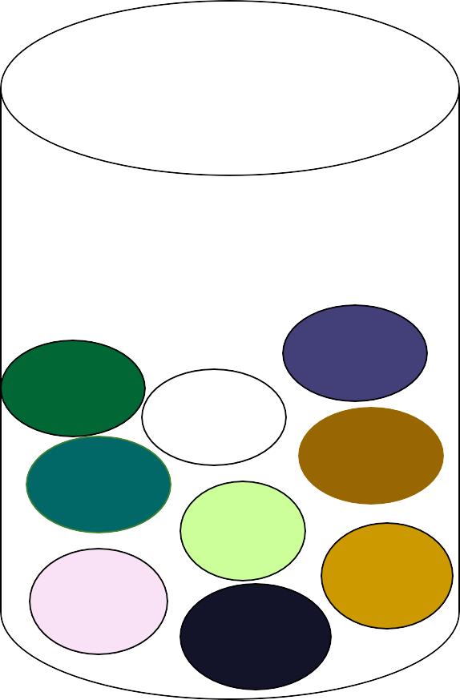
Sampling
SRSWOR
(simple random sample without replacement
SRSWR
Raw Data

Slide 60
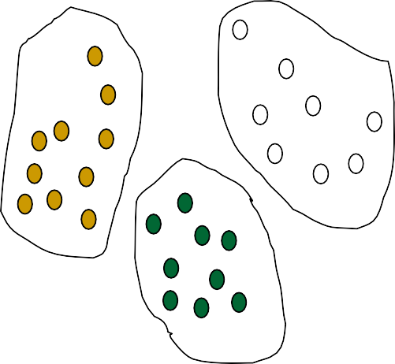
Sampling
Raw Data
Cluster/Stratified Sample

Slide 61
Hierarchical Reduction
Use multi-resolution structure with different degrees of reduction
Hierarchical clustering is often performed but tends to define partitions of data sets rather than “clusters”
Parametric methods are usually not amenable to hierarchical representation
Hierarchical aggregation
An index tree hierarchically divides a data set into partitions by value range of some attributes
Each partition can be considered as a bucket
Thus an index tree with aggregates stored at each node is a hierarchical histogram

Slide 62
Outline
Introduction
Data cleaning
Data integration and transformation
Data reduction
Discretization and concept hierarchy generation
Summary

Slide 63
Discretization
Three types of attributes:
Nominal — values from an unordered set
Ordinal — values from an ordered set
Continuous — real numbers
Discretization:
  divide the range of a continuous attribute into intervals
Some classification algorithms only accept categorical attributes.
Reduce data size by discretization
Prepare for further analysis

Slide 64
Discretization and Concept hierachy
Discretization
reduce the number of values for a given continuous attribute by dividing the range of the attribute into intervals. Interval labels can then be used to replace actual data values.
Concept hierarchies
reduce the data by collecting and replacing low level concepts (such as numeric values for the attribute age) by higher level concepts (such as young, middle-aged, or senior).

Slide 65
Discretization and concept hierarchy generation for numeric data
Binning (see sections before)
Histogram analysis (see sections before)
Clustering analysis (see sections before)
Entropy-based discretization
Segmentation by natural partitioning

Slide 66
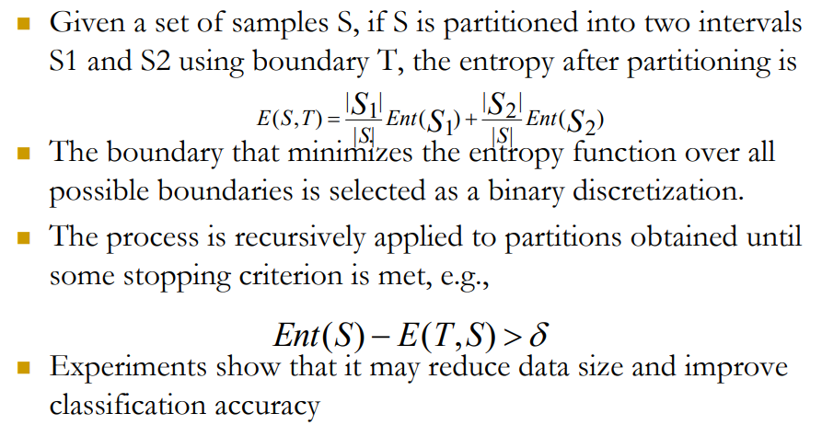
Entropy-Based Discretization

Slide 67
Segmentation by natural partitioning
3-4-5 rule can be used to segment numeric data into relatively uniform, “natural” intervals.
If an interval covers 3, 6, 7 or 9 distinct values at the most significant digit, partition the range into 3 equi-width intervals
If it covers 2, 4, or 8 distinct values at the most significant digit, partition the range into 4 intervals
If it covers 1, 5, or 10 distinct values at the most significant digit, partition the range into 5 intervals

Slide 68
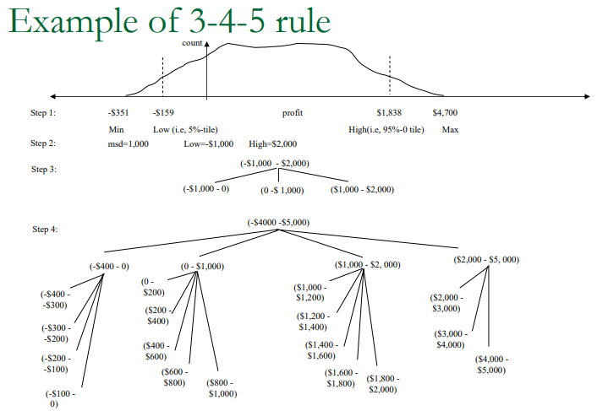

Slide 69
Concept hierarchy generation for categorical data
Specification of a partial ordering of attributes explicitly at the schema level by users or experts
Specification of a portion of a hierarchy by explicit data grouping
Specification of a set of attributes, but not of their partial ordering
Specification of only a partial set of attributes

Slide 70
Specification of a set of attributes
Concept hierarchy can be automatically generated based on the number of distinct values per attribute in the given attribute set. The attribute with the most distinct values is placed at the lowest level of the hierarchy.
country
15 distinct values
province_or_ state
65 distinct values
city
3567 distinct values
street
674,339 distinct values

Slide 71
Outline
Introduction
Data cleaning
Data integration and transformation
Data reduction
Discretization and concept hierarchy generation
Summary

Slide 72
Summary
Data preparation is a big issue for both warehousing and mining
Data preparation includes
Data cleaning and data integration
Data reduction and feature selection
Discretization
A lot a method have been developed but still an active area of research

Slide 73
Good data preparation is key to producing valid and reliable models

